Slide 1
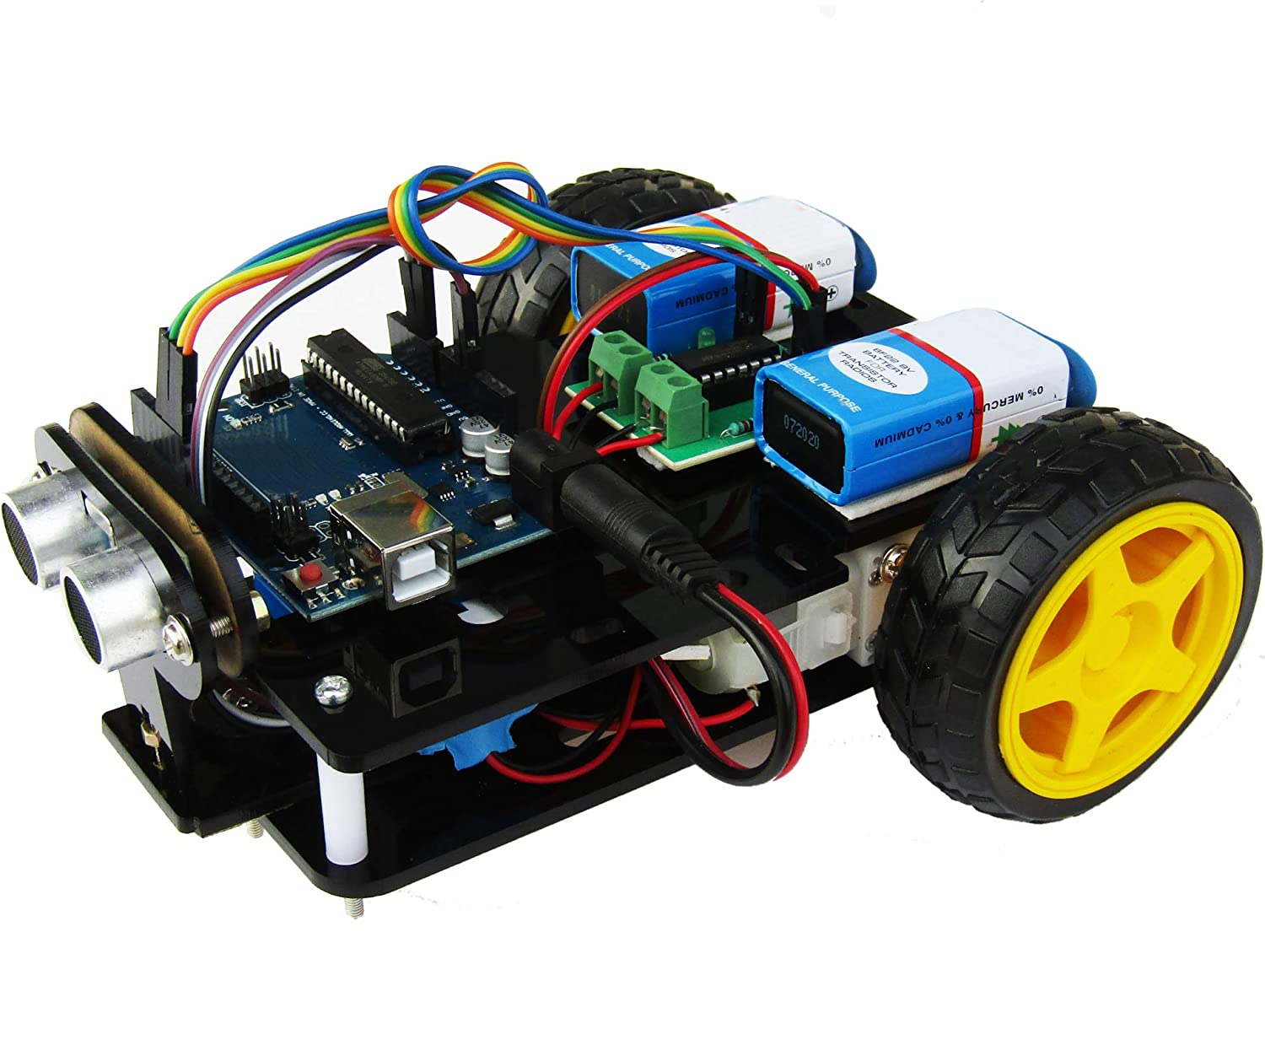
ROBOTICS
PROJECT
PROPOSAL
Saviour 1.0(Obstacle Avoiding Car)
Link for tinkercad

Slide 2
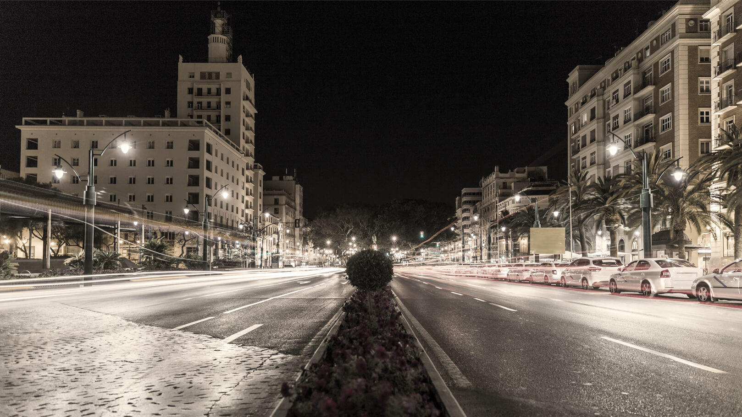
Objectives of Project
1) The main objective of Saviour 1.0 is to make obstacle avoiding car from scratch in cost effective manner.
2) To make Saviour 1.0 cost effective, it's components will be less dependent on pre-made sensor. Use of self-programmed sensors and design is promoted.
3) Saviour 1.0 is stable and self-dependent car which helps in preventing accidents and contribute to the path of fully autonomous cars.
4) Saviour 1.0 is user friendly and easy to operate, due to which it can be used by any person of 6+ age.
5) Special feature and sensors like tilt-sensor to halt the car functionality until it is turned over, LCD screen to display condition of path and no. of obstacle overcome are added to it.
6) In further Saviour series, upgrades will involve disaster management features to extinguish fire, rescue operations to find and lift heavy weight to which human tends to bow down, patrolling in tough situation and areas without getting in view of enemies due to its size and color.
“My opinion is it’s a bridge too far to go to fully autonomous cars.”
~ Elon Musk

Slide 3
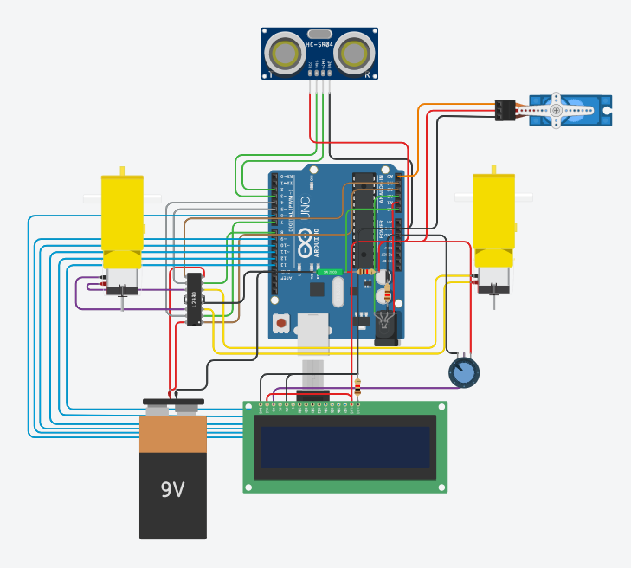
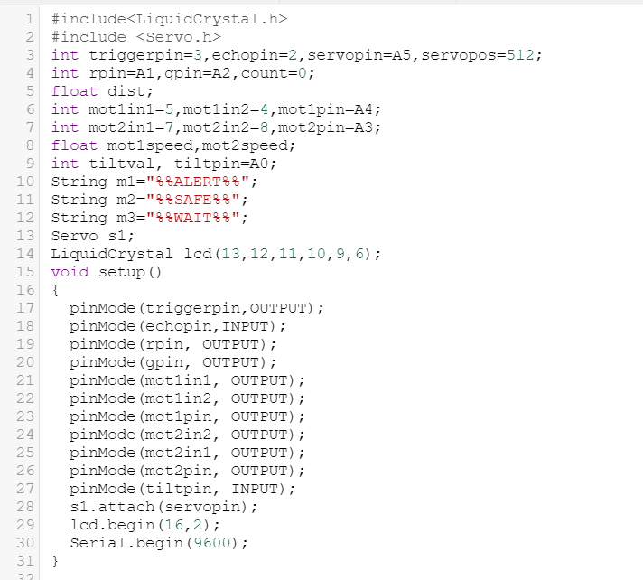
Saviour Circuit and Code

Slide 4
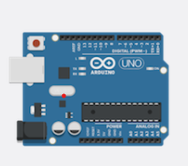
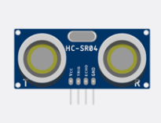
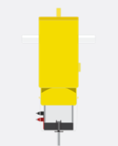
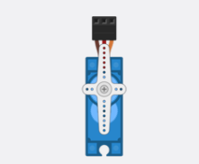
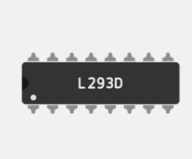
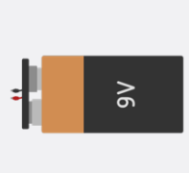
Arduino Uno
Ultrasonic Sensor
Hobby Gearmotor
Saviour 1.0 Essential Driver's Detail
Servo motor
Motor Driver
Power supply
It is a microcontroller board based on the Atmega328.
It is an electronic device that measures the distance of the target by emitting ultrasonic sound wave.
A gearmotor is an all-in-one combination of an electric motor and a gearbox.
A servomotor is a rotatory actuator or linear actuator.
It is an interface between motor and the control circuits.
A power supply is an electrical device that supplies electric power to an electrical load.

Slide 5
Budget
S no. | Items | Items details | Price(Rs) | Quantity | Total Price(Rs)
1. | Arduino | UNO R3 | 350 | 1 | 350
2. | Battery | 9V | 50 | 2 | 100
3. | Motor Driver | L293D | 60 | 1 | 60
4. | Motors | Hobby(250rpm),Servo | 65,100 | 2,1 | 230
5. | Sensor | Ultrasonic , Tilt Sensor | 100,50 | 1,1 | 150
6. | Potentiometer | 250 K Ω | 30 | 1 | 30
7. | Wire, Resistor , LED | Jumper wires ,(1K Ω), RGB | 100 | 1 | 100
8. | Frame | Steel Rim | 500 | 1 | 500
9. | Extra Stuff | Tyre, Caster Steel Ball Wheel, LCD(16*2) | 25,150,200 | 2,1,1 | 400
Grand Total :- Rs1713

Slide 6
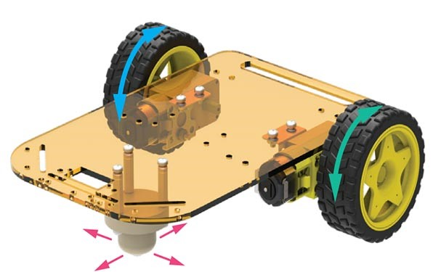
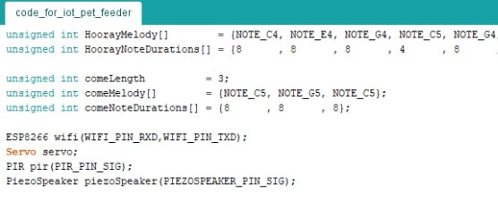
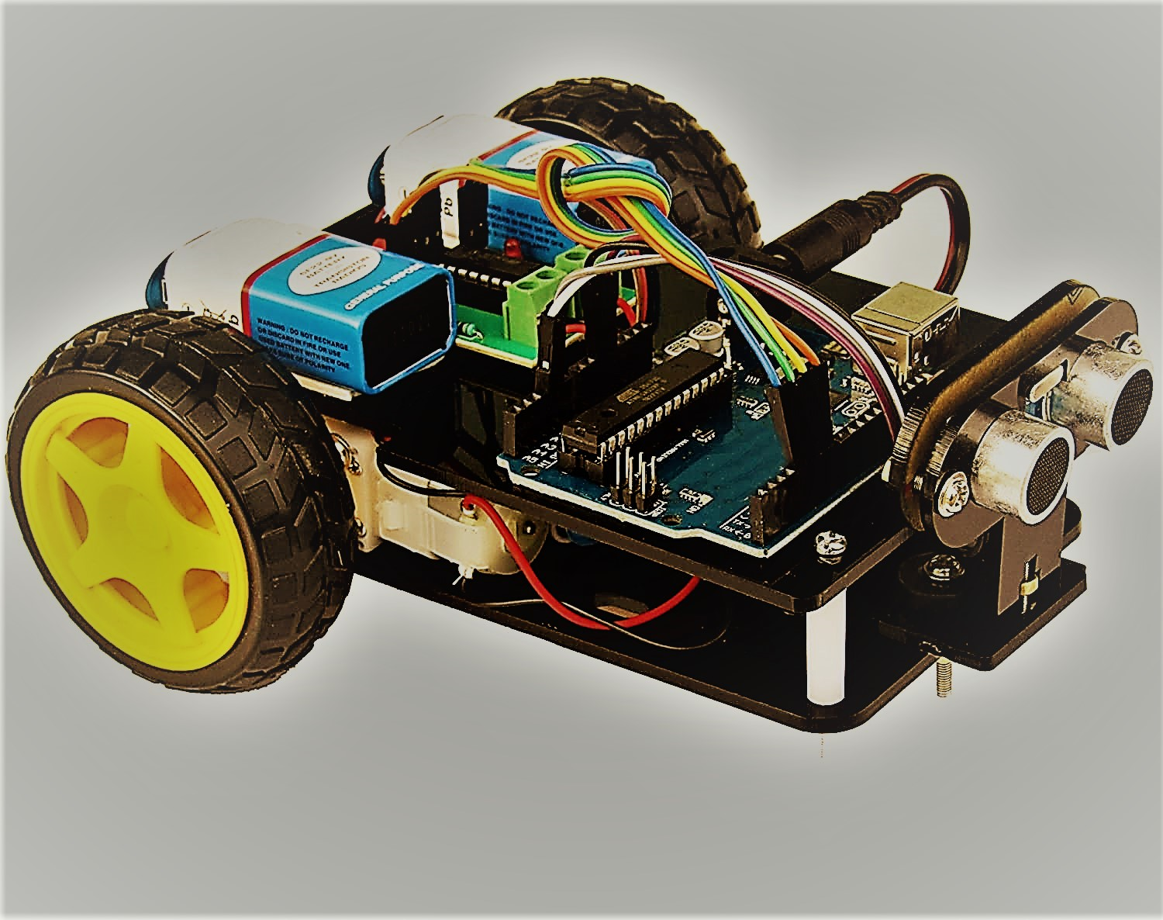
STAGE 1
PROJECT STAGES
STAGE 2
STAGE 3
Basics framework of obstacle avoiding car.
Circuit design, programming and including additional functionalities in car .
Experimenting in different conditions and improving stability .

Slide 7
TIMELINE
Day 2
Day 4
Day 6
Understanding implementation of HC-SR04 ultrasonic distance sensor and its conversion of units.
Including addition feature of tilt sensor to stop car in case it falls over and LED bulb to display alert lights.
Including LCD display to show alert messages and no. of obstacle overcome by car.
Day 1
Day 3
Day 5
Basic Analysis of Robotic Car. Working and understanding of Hobby Gear motor/L293D Driver.
Understanding and addition of Servo motor to rotate distance sensor to see obstacle around car.
Assembled various components and checked the working of motor car in various conditions.

